Slide 1
CPE 301 Project Presentation
David Pajar
(pajard1@unlv.Nevada.edu)
Rimon Sawa
(sawar1@unlv.Nevada.edu)

Slide 2
AIM & ACCOMPLISHMENT
AIM:
Build a moving remote controlled robot using Atmega328P microcontroller.
ACCOMPLISHMENT
Program to control the DC motors using RF.

Slide 3
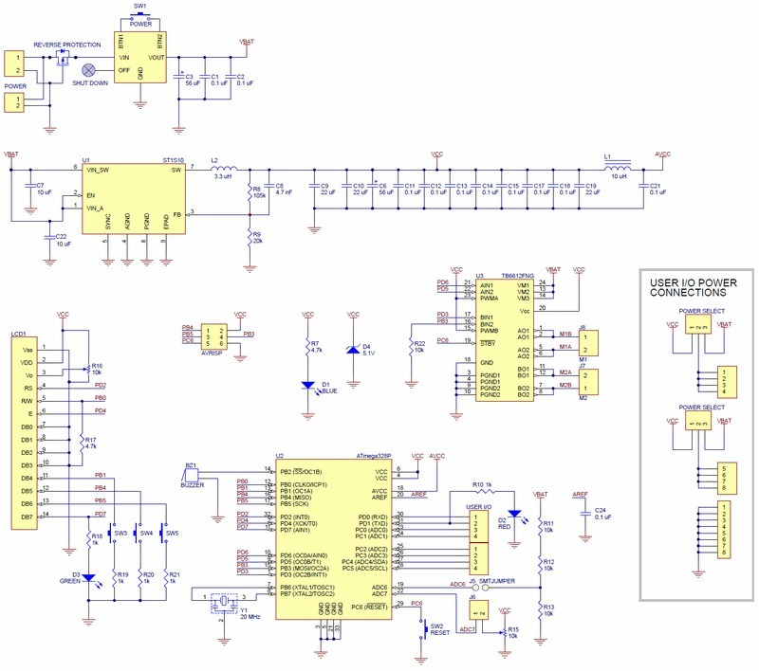
SCHEMATICS

Slide 4
DESIGN STAGES
Components
L293D IC
iPhone
NodeMCU
ATMEGA328p
Interfaces
Atmega328p
NodeMCU
USART

Slide 5
CODE DEVELOPMENT
Initialization
Control DC motors, Then USART is initialized. Header files are implemented. Then a continuous loop is added. PWM on the microcontroller controls the motors while USART transmits. Arduino program NodeMCU is established.

Slide 6
DEMO SNAPSHOT/VIDEO
https://youtu.be/EYaKe_ahoAY

Slide 7
Group Projects
Student Name: David Pajar
Task Completed: Wiring/debugging/Programming
Contribution % towards the project:50%
Coding (%):50%
Implementation (%):50%
Testing/Demo (%):50%
Documentation (%):50%
Presentation (%):50%

Slide 8
Group Projects
Student Name: Rimon Sawa
Task Completed: implementing USART code/Powerpoint/debugging
Contribution % towards the project:50%
Coding (%):50%
Implementation (%):50%
Testing/Demo (%):50%
Documentation (%):50%
Presentation (%):50%

